Slide 1


Georgian Technical University, Institute of Cybernetics B Besarion Partsvania, Tamaz Sulaberidze, Alexandre Khuskivadze, Sophio Abazadze Alternative optical techniques for assessing the aggressiveness of prostate cancer
INTRODUCTION:
A comprehensive review of global cancer statistics confirms that prostate cancer is the second most common cause of cancer death in men, directly after lung cancer, emphasizing its significant impact on men's health worldwide [1]. A study indicated that PSA (prostate-specific antigen) screening resulted in a 20% reduction in prostate cancer mortality. Despite the benefits of screening, prostate cancer remains a leading cause of cancer-related deaths, with significant mortality rates persisting. - Schröder 2003, McLaughlin 2024.

Slide 2
.
Therefore, instrumental screening methods are of great importance. However, each of them has its weaknesses. For example, a digital rectal examination (DRE) is highly subjective and is based on the skills and expertise of the doctors. Leen 2018.
The next method is transrectal ultrasound (TRUS). Prostate cancer may be identified on TRUS as a hypoechoic lesion. However, only 60% of prostate cancers appear hypoechoic on ultrasound. Consequently, TRUS should not be used as a first-line screening study, as it lacks acceptable specificity. Harvey, 2012.
MRI—Magnetic resonance imaging is an expensive and complicated method that requires a radiologist and a physician specifically trained to supervise and interpret radiology examinations. Besides, the strong magnetic field might be harmful. Sometimes it is difficult to obtain clear images due to the presence of an implant or other metallic object. The same result can be achieved via patient movement. A prostate biopsy can occasionally result in inflammation or the presence of blood products within the prostate, which MRI cannot always discriminate from cancer tissue. Coakley 2003.
CT—computer tomography—is not regarded as the primary method for prostate cancer diagnosis. CT usually is used as an additional tool in prostate cancer diagnosis. Restrictions: X-rays are not non-invasive. Daryanani 2022. PET—positron emission tomography—is extremely complicated, expensive, and partially invasive. Thereby, this method could not be widely used in common clinics.Bailey 2005.

Slide 3
Introduction
Due to the limitations of current imaging techniques, we were motivated to seek an alternative technique that would enable us to identify prostate cancer at an early stage of development, which would then serve as a basis for performing a targeted biopsy. In order to meet this challenge, we made an effort to create a new technique for visualization of prostate cancer employing infrared light.

Slide 4
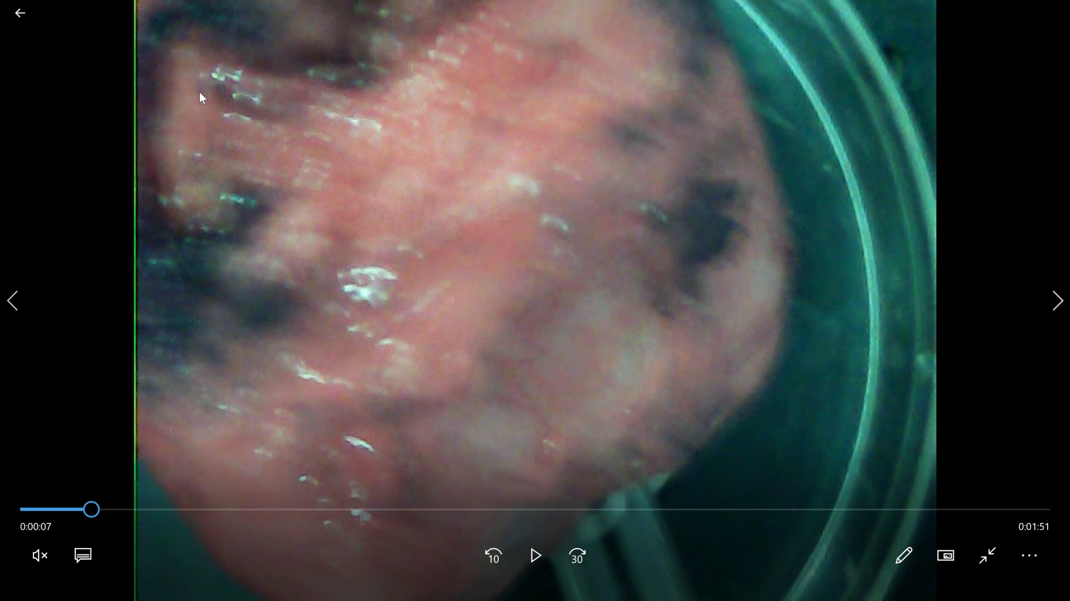
Introduction
In this slide we demonstrate usage of IR light for obtaining an IR image of a whole isolated prostate. We see an isolated prostate with a catheter inside the urethral channel. The LED is inserted into the catheter and illuminates the prostate from inside with IR light. We obtain an IR image. Here dark areas correspond to malignant tissue, while lighter areas correspond to noncancerous tissue.

Slide 5
Introduction
An effective treatment for prostate cancer is a radical prostatectomy; however, it is not the final step. Unfortunately, 30-40% of patients after surgery develop a local recurrence. Scattoni et al. 2004. Probability of recurrence in prostate cancer is directly proportional to the degree of aggressiveness of tumor and is higher in the case of higher aggressiveness of the tumor. Grossfeld et al. 2003 Han et al, 2001, Bianco et al., 2003.
In prostate cancer, the degree of aggressiveness is determined by the sum of the Gleason score. The aggressiveness of cancer is not dependent on the developmental stage. It may happen so that the initial cancer may be very small, however very aggressive. Murata et al., 2018.
Postoperative management of needed treatment is determined by histomorphological investigations, performed on isolated prostate specimens after surgery, and largely depends on how aggressive the cancer was in the prostate. If a high degree of aggressiveness (i.e., high sum of the Gleason score) is not accurately detected, then postoperative management would be incorrectly selected, and the risk of cancer recurrence increases. Vachani 2018.

Slide 6
Introduction
In order for the pathomorphological response to be 100% accurate, microscopic investigation of all parts of the entire prostate should be made, which is a highly laborious and time-consuming activity. Thereby, this type of examination is not practiced. Most clinics use partial selection practices. The reason for the high percentage of cancer recurrence is that the partial sampling method often fails to fully detect areas with a high degree of aggressiveness, resulting in incorrect postoperative management selection and recurrence of cancer.
The main weaknesses of this approach that lead to the mentioned errors are the following:
a) Usually, from each prostate gland, 30-40 slices are prepared for examination under the microscope. To do this, the isolated prostate is firstly processed into formalin, then cut into layers 5-6 mm thick. Then slices are randomly taken from layers in a non-automatized manner. True, 1994; Bova et al.1993. This is extremely insufficient to examine the entire prostatic tissue.
b) The prostate tumor is morphologically diverse and multifocal. Cancers of different aggressiveness can be found in the same prostate. It is virtually impossible to detect the location of the tumor with the naked eye. Often, cancer is spread in the whole prostate gland with small acinus. Faraz et al., 2015. Different acini may have different degrees of aggressiveness.

Slide 7
Introduction
Thus, it is likely that a small part of a highly aggressive tumor could be missed during preparation of the slices and would not be detected. Consequently, targeted histological examination is not possible. Considering this, we would not have the information about highly aggressive cancer. Thereby, the treatment management plan would be incorrect. Existing approaches to computer-assisted evaluation of histopathological preparations of the prostate employ the fact that the glands are usually first separated from stroma. This task is difficult and prone to detection errors due to a large spectrum of gland architectures in benign and cancerous areas. Besides, computer-assisted gland segmentation techniques utilize the presence of the glandular lumen as a prominent feature that requires highly sophisticated image processing routines.

Slide 8
Methods
In the experiments, prostates obtained after radical prostatectomy were utilized.
It is well known that a certain technique is used to cut the prostate in order to detect the aggressiveness based on the Gleason score of cancer after surgery. For this purpose a formalin-fixed paraffin-embedded tissues (FPE) are obtained for processing the specimens.
After this, a microtome is used to cut slices from FPE for microscopic analyses. The slices mounted on the slide glass (SMG) are obtained after a well-known processing step.
It is easy to understand that FPE and SMG are complementary. Their localized cancer distributions are one and the same. Additionally, their distribution of aggressive patterns is also one and the same.
Due to the mentioned weaknesses, we decided to administer our IR visualization method for obtaining IR images of FPE.

Slide 9
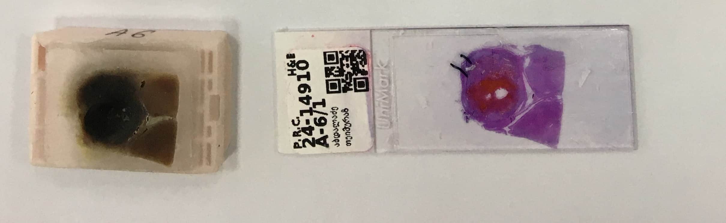
On this slide is shown one of the FPEs, MSG taken from it
Figure 1.

Slide 10
Methods
Using the infrared method, we get a two-dimensional (2D) IR image of an FPE. We compare the various illumination intensities on the infrared image to the tumor's aggressiveness on SMG.
It is well known that light at wavelengths in the invisible near-infrared (NIR) range (from 750 to 1350 nm) is a noninvasive optical tool to detect and image tissue abnormalities. For example, optical mammography has been studied as an alternative technique, which utilizes NIR light to image cancerous breast lesions. Fantini and Angelo 2012.

Slide 11
Methods
Our studies imply the obtaining and analyses of 2D trans-illumination images.
Optical densities of the cancerous and healthy tissues are different, and the intensities of the infrared rays after passing through them will be different from each other. I.e. The intensity of the infrared light coming out of the cancerous tissue will be much less than the intensity of the infrared rays passing through the healthy tissue. Partsvania et al. 2014. Partsvania et al. 2016, Partsvania et al. 2017.
In our experiments infrared rays travel in about 5-6 mm thick in a prostate tissue. Infrared rays in biological tissue are characterized by multiple scattering. However, the NIR in the 750-1000 nm range is characterized by fairly deep penetration and minimal scattering. Caerwyn at al. 2017.
The infrared method allows us to obtain 2D IR images and study the correlation of different light intensities with the aggressiveness' of cancer in prostate specimens.

Slide 12
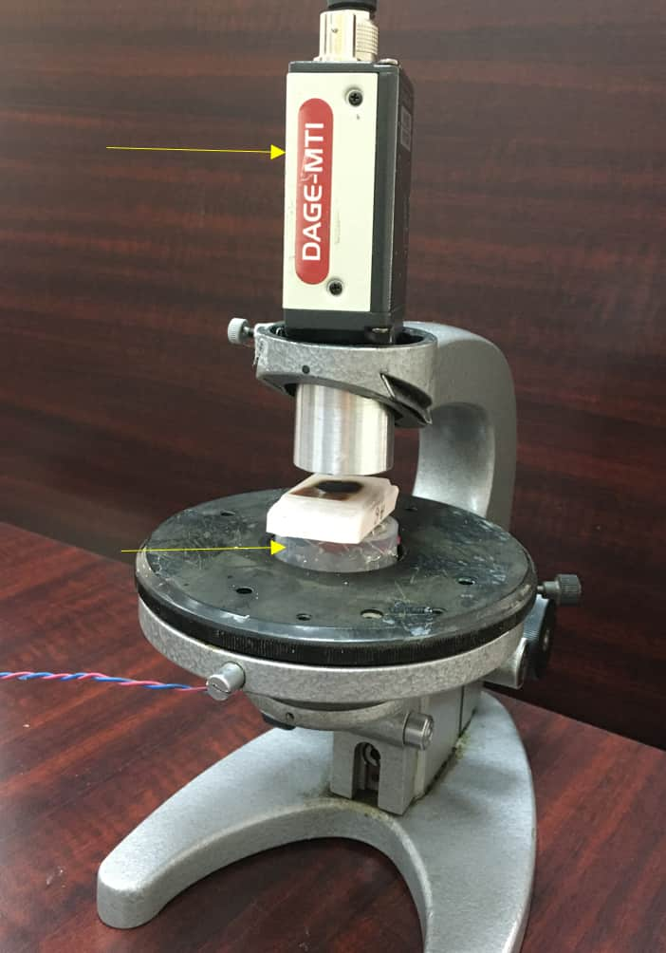
Experimental Unit.
Figure 2. FPE is placed between CCD camera and LEDs.
The experimental unit consists of an infrared radiation source, a holder for cancerous tissue, and a CCD camera. Rays emanating from the infrared source pass through tissue.

Slide 13
Methods
The CCD camera matrix contains a certain number of pixels. The intensity of infrared radiation falling on each pixel is determined by the intensity after passing from the investigated biological tissue. Therefore, the distribution of the intensities on the CCD matrix corresponds to the pattern of the intensities of the IR passing from the biological tissue. As it is well known, a CCD camera converts the intensity of an infrared ray falling on each pixel into an electrical signal of the corresponding magnitude, the value of which is proportional to this intensity.
Signals are transmitted from the CCD camera to the computer.
In the case of homogeneity of the study tissue, the intensity of the infrared rays passing from all points of the tissue will be the same. If the tissue is heterogeneous, for example, it contains both cancerous and healthy tissue because the optical densities of these tissues are different, the intensities of the infrared light passing from them will be different from each other. Partsvania 2014, Partsvania 2016, Partsvania 2017.

Slide 14
Methods
To use an infrared approach for investigating the aggressiveness of prostate cancer, we utilized both FPE and their corresponding SMG.
The experiment was carried out in the following order: at first, SMGs were examined under a microscope. The structure of the cancerous tissue was determined, and the aggressiveness was evaluated in individual areas.
Next, we identified dark areas in an FPE's infrared picture and discovered that these corresponded to the certain SMG's malignant regions.

Slide 15
Software Development
We developed software for IR image analysis. The software assigns to each point of the IR image the number from 0 to 255 according to its brightness. 0 is given to a maximally dark point and 255 to a point with the maximum brightness. In this way, the software measures the light intensities at each point on the IR image, which corresponds to both the tumor and the healthy tissue. Then the software calculates the mean values of these illumination intensities separately for malignant and healthy areas. After this, the software calculates the ratio of these numbers (malignant to healthy ratio, MHR). The obtained ratio is stored in the memory of the software. This procedure was made for 30-32 samples of given aggressiveness. After software calculates the interval of these MHRs with 95% probability, it is called the 95% confidence interval.
Any unknown sample that we later examine would go through the same MHR measurement process. Software computes a single value rather than an interval when dealing with a single specimen. We may say with 95% certainty that the aggressiveness of the new specimen matches (is equal to) the aggressiveness we found for the interval if the obtained number "falls" into the above computed interval.
Hence, on the one hand, we know the aggressiveness degree of the tumor areas identified by histomorphological studies, and on the other hand, the ratio of the mean value of the illumination of the corresponding tumor area to the mean value of illumination of healthy tissuee—i.e. MHR. Thus, results obtained from histo-morphological studies were compared to the results obtained by the infrared method. In this manner we determined what degree of aggressiveness corresponds to the certain ratio of intensities—MHR.

Slide 16
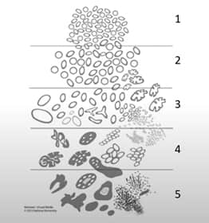
5 grade of prostate cancer
Figure 3. 5 grade of prostate cancer aggressiveness according to College of American Pathologists [21]. Protocol for the examination of radical prostatectomy specimens from patients with carcinoma of the prostate gland (Version 4.3.0.0). https://documents.cap.org/protocols/Prostate_4.3.0.0.REL_CAPCP.pdf

Slide 17
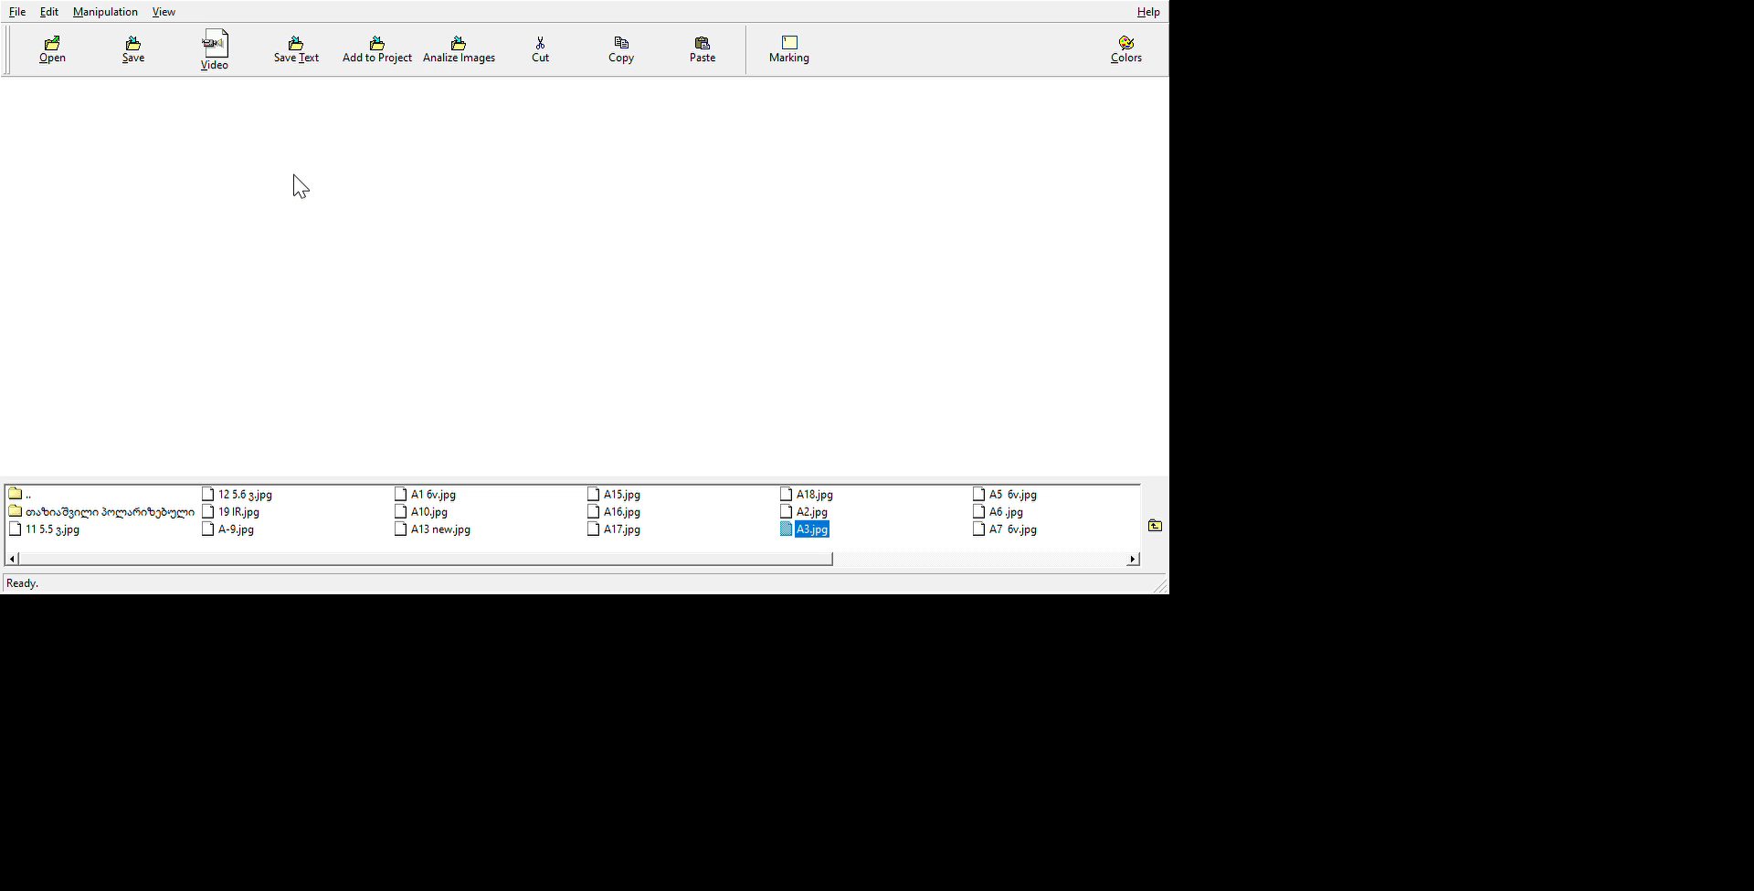
How works software

Slide 18
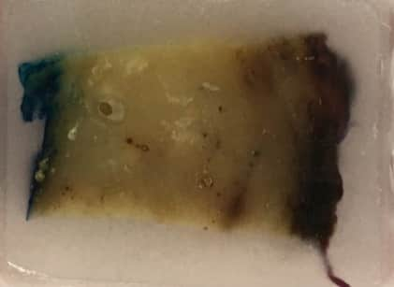
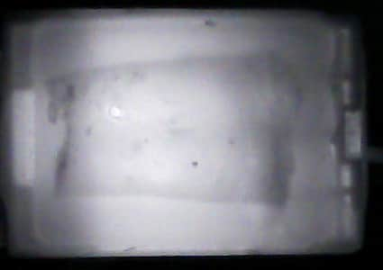
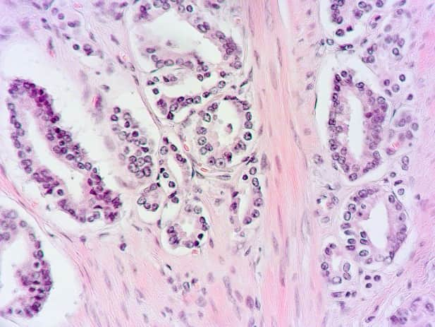
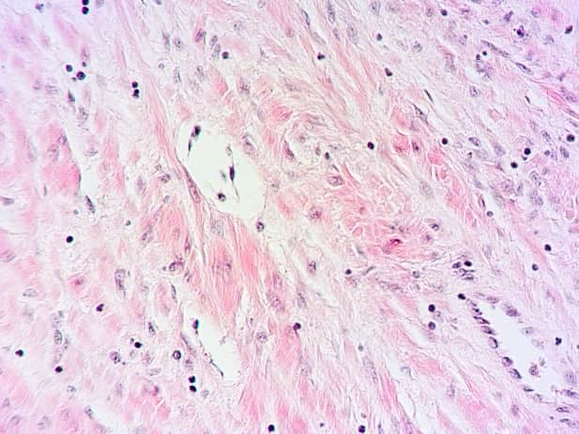
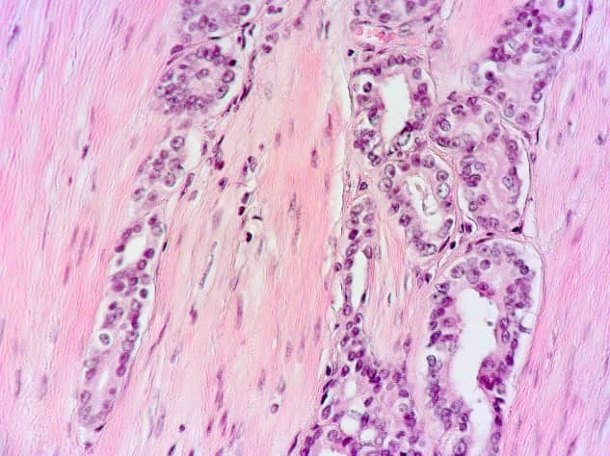
Results
Prostate cancer is typically multifocal. It is common to detect different levels of aggression in the same prostate, but if prostate cancer is still in its early stages, we typically obtain one type of aggressiveness. One of such FPE is shown on this slide, together with its infrared image and histomorphological images of several sections extracted from the relevant SMG.
Asddc
Figure 4. Arrows are used to connect histo-morphological images to their respective locations on the infrared image. In this case Grade according to College of American Pathologists was 2. Middle histo-morphological picture corresponds to healthy tissue of prostate.

Slide 19
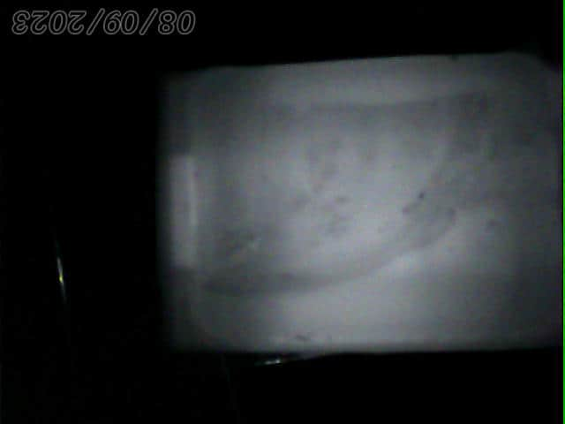
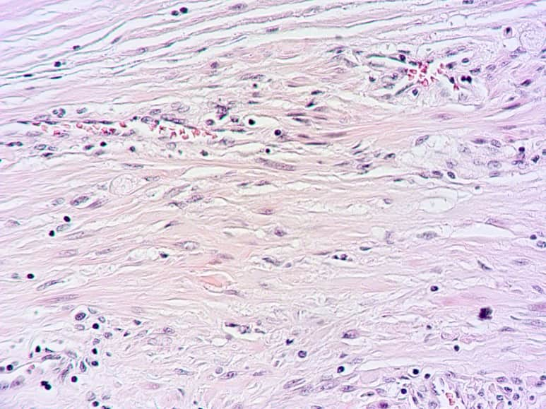
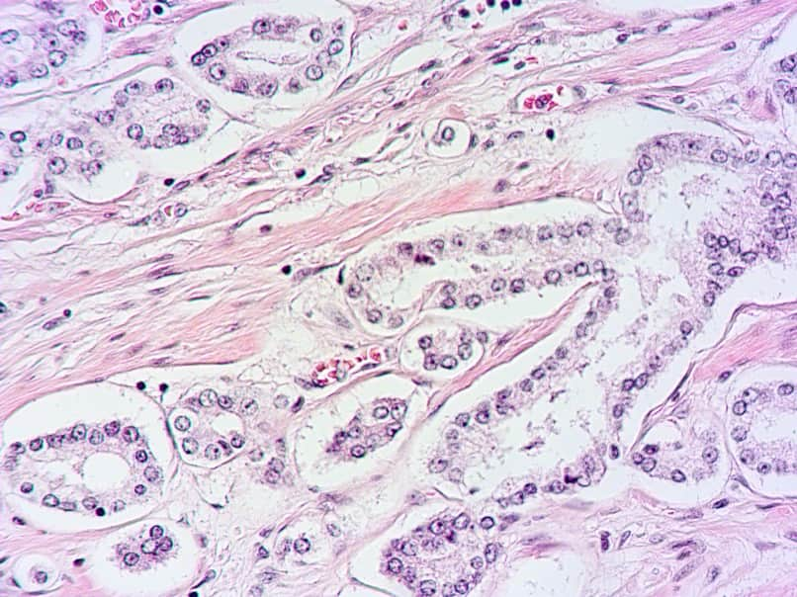
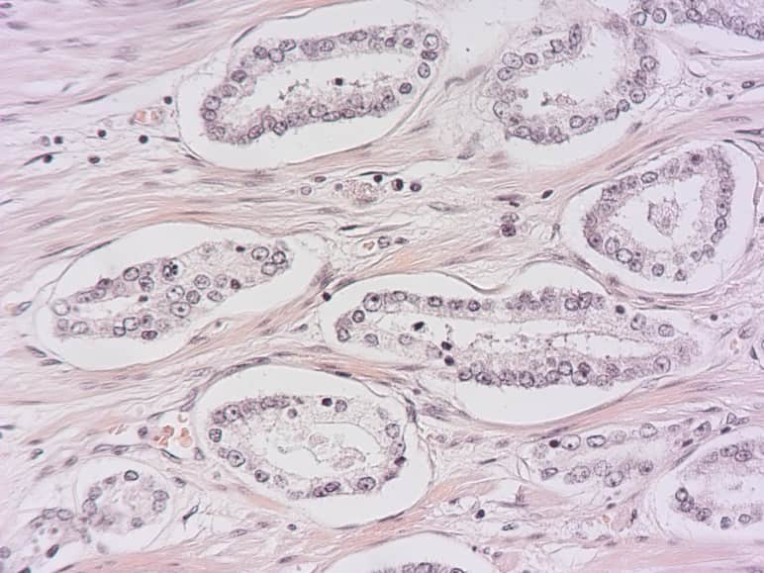
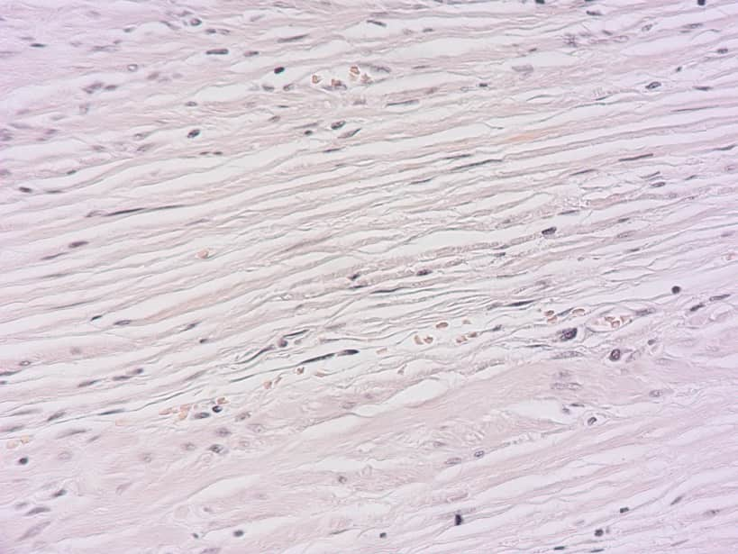
Another example of the IR image of the FPE with cancer aggressiveness 2 .

Slide 20
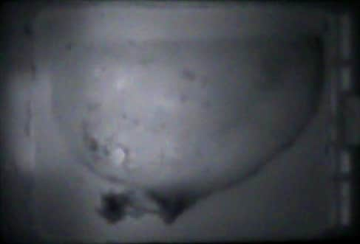
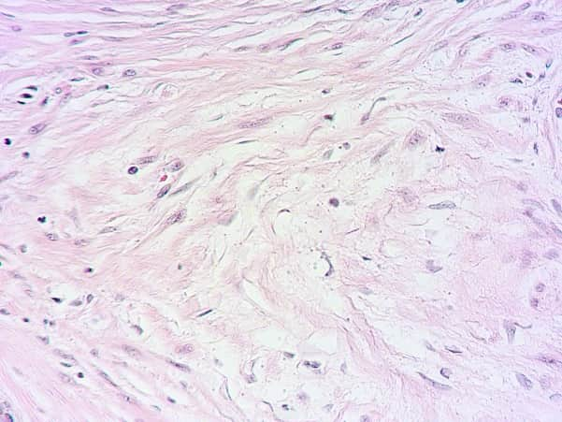
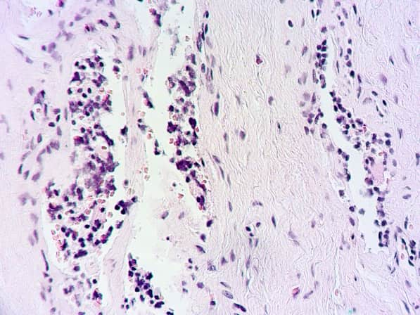
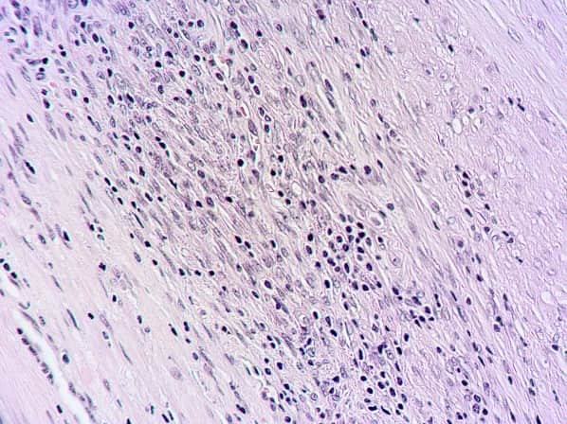
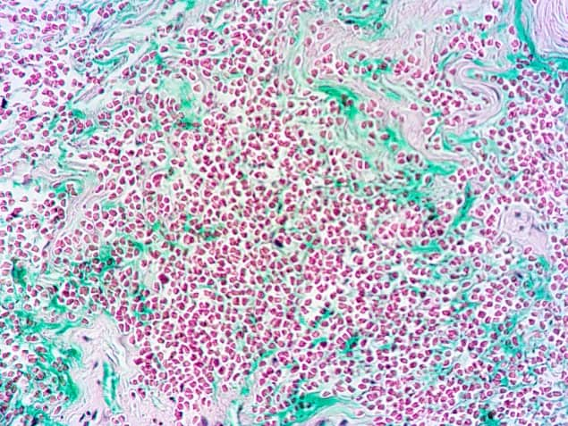
Results
The IR image of FPE and histomorphological images from several locations are displayed on this slide. Here, aggressiveness mostly was rated at 3 (yellow arrow), however small portions of higher aggressiveness was met (red and orange arrows).
Figure 6. Arrows are used to connect histomorphological images to their respective locations on the infrared image. On the right from the IR image is picture of healthy tissue (black arrow).

Slide 21
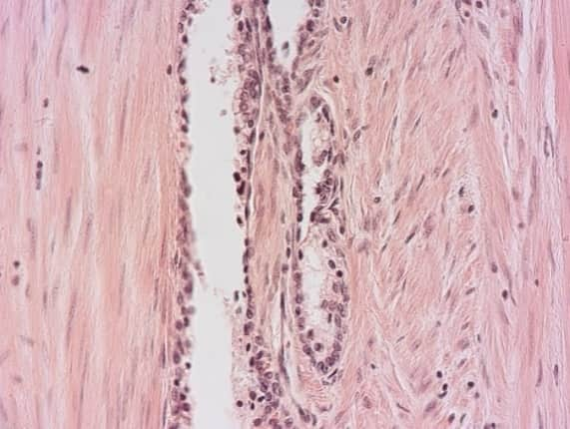
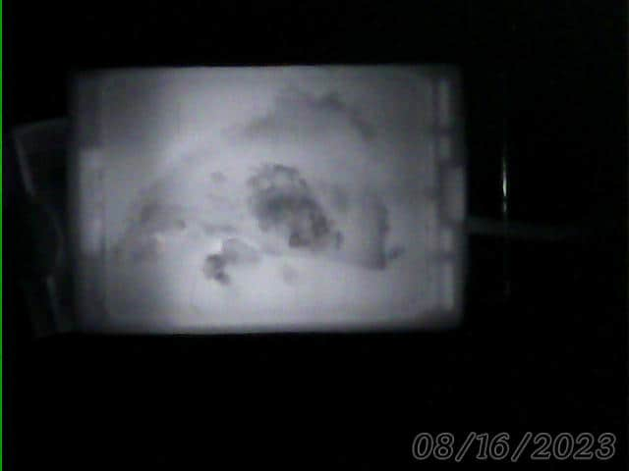
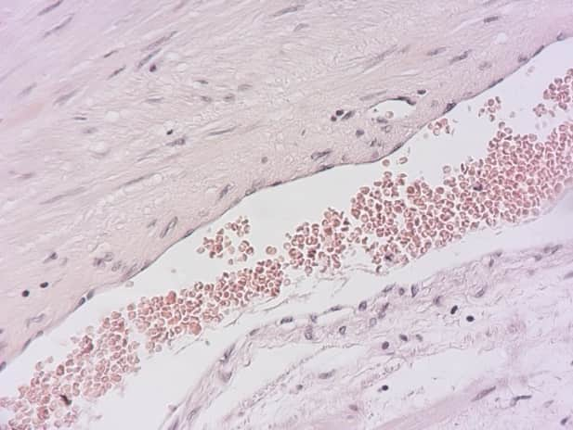
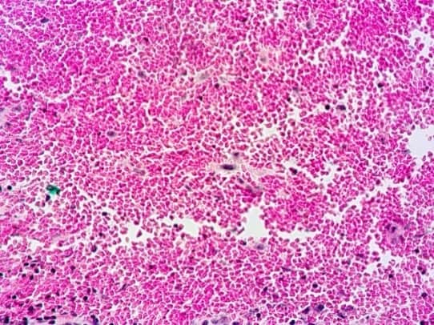
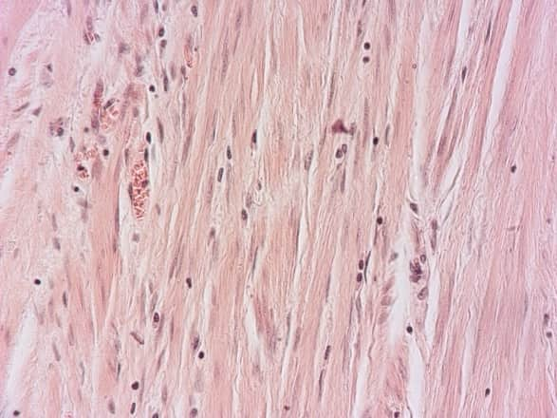
IR image of prostate tissue with different aggressiveness.
Figure 7. Here we see site with aggressiveness 5 (yellow arrow), aggressiveness 3 (green arrow), aggressiveness 4 (blue arrow), and healthy tissue (black arrow).

Slide 22
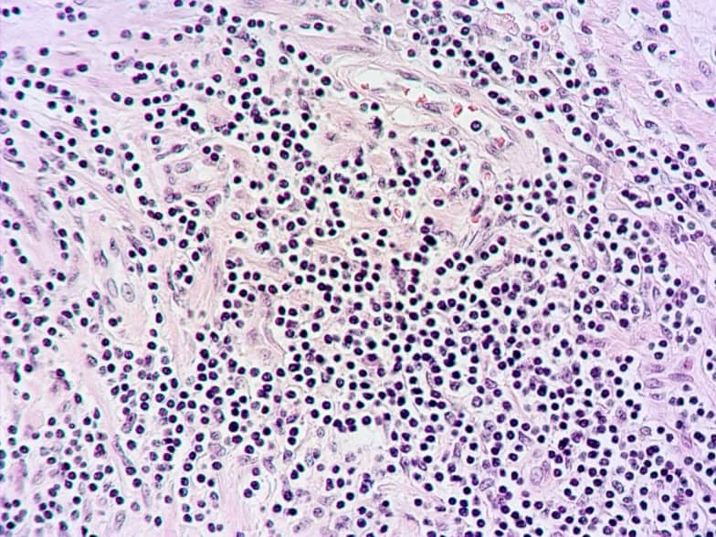
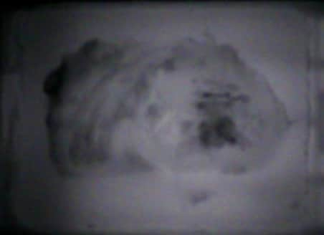
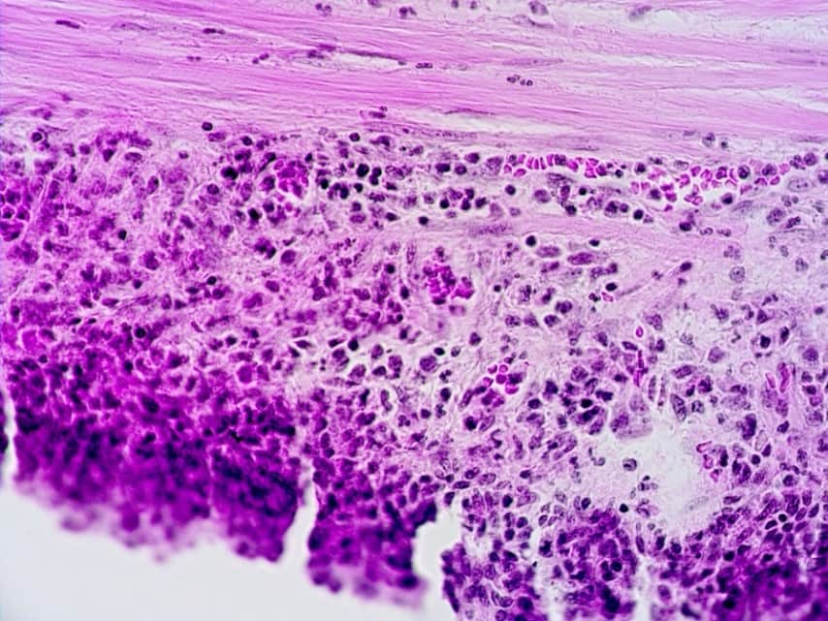
Results
The situation when the majority of the aggressiveness was 5 is depicted on this slide.
Figure 8. IR image of FPE of prostate tissue with aggressiveness 5 . Arrows indicate sites on the IR image at which the histo-morphological images are taken. On the right histo-morphological image we see the margin of cancerous formation which is well seen on the IR image also - see black arrows.

Slide 23
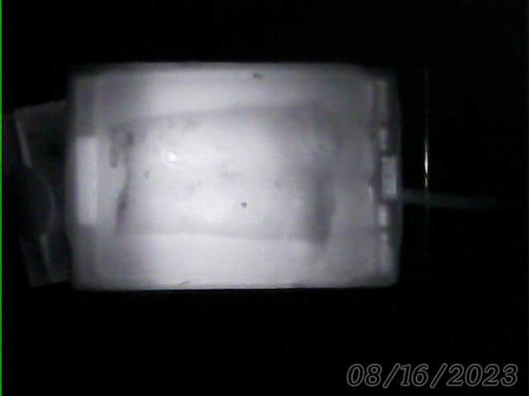
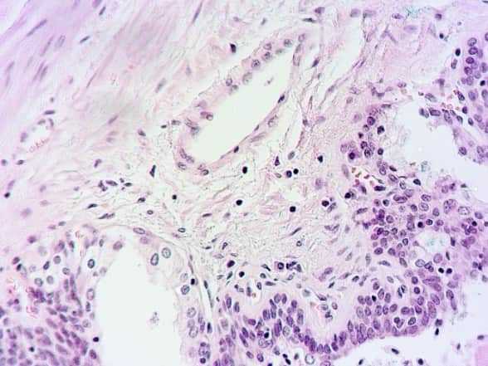
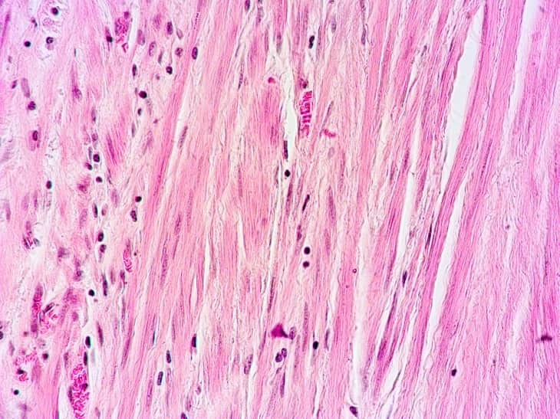
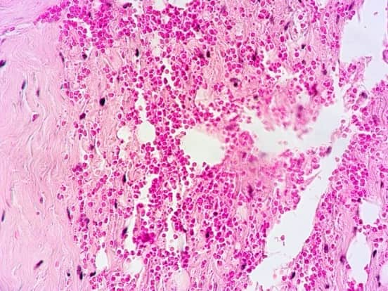
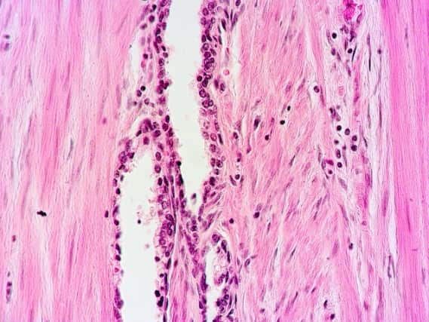
Results
In this slide we see examples when different aggressiveness levels are present; however, the highest one (aggressiveness 5) is of very low percentage (yellow arrows).
Agressivness 4
Agressivness 5
Healthy tissue
Agressivness 5
Figure 9 .

Slide 24
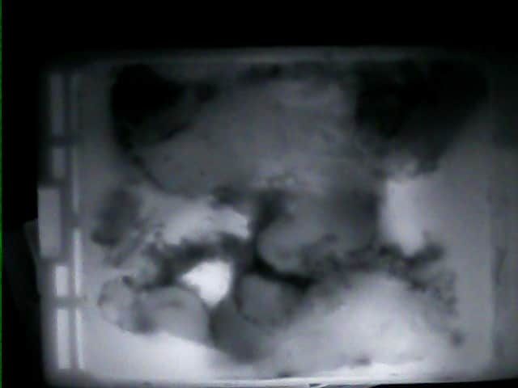

Results
On this slide is shown example when only one (highest) aggressiveness -5 is present.
Figure 19.

Slide 25
Results
.
Each level of aggressiveness was the subject of at least 32 tests, for a total of 190. As it occurred, our software can differentiate between three levels of aggressiveness. Specifically, the 95% confidence interval of MHR for 2 degrees of aggressiveness occurs at 6.8-7.2.
Aggressiveness 3 and aggressiveness 4 have one and the same interval of their MHRs. It is between 5.2 - 6.1. (Thus, two types of tissue experience the same item.) And for aggressiveness of the 5th degree, MHR is 4.4-5.0. These intervals do not overlap, as we can see.
Thus we see that the infrared technique accurately detects and differentiates between higher levels of aggressiveness, which was the project's objective.

Slide 26
Conclusion
The infrared imaging method is characterized by higher reliability for visualization of cancerous formations with higher degrees (4 and 5) of aggressiveness.
In the case of investigation whole prostate prior surgery it allows for performing targeted biopsies and reducing the number of biopsy points. The IR method can be used as an alternative method to determine the aggressiveness of prostate cancer both before surgery and after radical prostatectomy, as the purpose of postoperative aggressiveness research is to identify areas of higher aggressiveness.
Thank you for attention

Slide 27
References
1.Rawla P. Epidemiology of Prostate Cancer. World J Oncol. 2019 Apr;10(2):63-89. doi: 10.14740/wjon1191. Epub 2019 Apr 20. PMID: 31068988; PMCID: PMC6497009.
2.Schröder FH, Hugosson J, Roobol MJ, Tammela TL, Ciatto S, Nelen V, Kwiatkowski M, Lujan M, Lilja H, Zappa M, Denis LJ, Recker F, Berenguer A, Määttänen L, Bangma CH, Aus G, Villers A, Rebillard X, van der Kwast T, Blijenberg BG, Moss SM, de Koning HJ, Auvinen A; ERSPC Investigators. Screening and prostate-cancer mortality in a randomized European study. N Engl J Med. 2009 Mar 26;360(13):1320-8. doi: 10.1056/NEJMoa0810084. Epub 2009 Mar 18. PMID: 19297566.
3. McLaughlin PW, Cousins MM, Tsodikov A, Soni PD, Crook JM. Mortality reduction and cumulative excess incidence (CEI) in the prostate-specific antigen (PSA) screening era. Sci Rep. 2024 Mar 9;14(1):5810. doi: 10.1038/s41598-024-55859-z. PMID: 38461151; PMCID: PMC10925039.
4.Leen, N., Harkanwal, R., Zahra, S., et al. 2018. Digital Rectal Examination for Prostate Cancer Screening in Primary Care:.A Systematic Review and Meta-Analysis. An Fam Med. 16(2): 149-154. doi: 10.1370/afm.2205
5. Harvey, C.J., Pilcher, J., Richenberg, J., Patel, U., Frauscher, F. 2012. Applications of transrectal ultrasound in prostate cancer. Br J Radiol. 85(Spec Iss 1) S3-17. doi: 10.1259/bjr/56357549.
6. Coakley, F.V., Qayyum, A., Kurhanewicz, J. 2003. Magnetic resonance imaging and spectroscopic imaging of prostate cancer. J Urol. 170(6 Pt 2):S69-75; discussion S75-6. doi: 10.1097/01.ju.0000094958.23276.c4.
7. Daryanani, A., Turkbey, B. 2022. Recent Advancements in CT and MR Imaging of Prostate Cancer. Semin Nucl Med. 52(3):365-373. doi: 10.1053/j.semnuclmed.
Formica, D., Silvestri, S. 2004. Biological effects of exposure to magnetic resonance imaging: an overview. Biomed Eng Online. 22(3). doi: 10.1186/1475-925X-3-11.
8. Bailey, D.L, Townsend, D.W., Valk, P.E., Maisy, M.N. 2005. Positron Emission Tomography: Basic Sciences. Secaucus, NJ: Springer-Verlag. ISBN 978-1-85233-798-8.

Slide 28
9. Abazadze S, Khuskivadze A, Kochiashvili D, Partsvania B. DEPENDENCE OF PROSTATE TISSUE PERMEABILITY ON THE WAVELENGTH OF RADIATION IN THE INFRARED RANGE OF THE SPECTRUM. Georgian Med News. 2021 Dec;(321):111-115. PMID: 35000918
10. Partsvania B, Sulaberidze T, Khuskivadze A, Abazadze S. Mini Review of Prostate Cancer Diagnostics . Novel Approaches in Cancer Study, 2019, 3 (5), 27-32
11. Partsvania B, Sulaberidze T, Khuskivadze A . An alternative method for prostate cancer diagnosis. European Urology Supplements 2019.18(12):e3626-e362.
12. Besarion Partsvania, Giorgi Kochiashvili and Alexander Khuskivadze. Utilization of the Polarized Infrared Light for Prostate Cancer Visualization in Isolated Prostates. Journal of Clinical Experimental Oncology 2018 7:1. 28-33.
13. Giorgi Kochiashvili , Alexandre Khuskivadze , Besarion Partsvania , Ketevan Chubinidze. Polarized infrared light enables enhancement of histo-morphological diagnosis of prostate cancer. Australasian Medical Journal. 2018. 11(9): 453–458.
14. Besarion PArtsvania. Possibility of using near infrared irradiation for prostate cancer imaging and its early diagnosis. Journal of Bioengineering & Biomedical Science 2016. 6:5 (supp)
15. Besarion Partsvania, Tamaz Sulaberidze, Gia petriashvili, Alexandre Khuskivadze and Levan Shoshiashvili. Near infrared trans illumination detection of prostate carcinoma in vitro. J Cancer Science & Therapy 2016, 8:9(Suppl)
16. B. Partsvania, T. Sulaberidze, A, Khuskivadze, L. Shoshiashvili, K. Chubinidze. Infrared light enables visualization of the prostate carcinoma after radical prostatectomy. Oncology Discovery. 2016. 4:2 , 5-42
17. B. Partsvania, T. Sulaberidze, A, Khuskivadze, L. Shoshiashvili, K. Chubinidze. Near Infrared Trans illumination Technology as Additional Tool for Prostate Cancer Detection in vitro after Prostatectomy. International Journal of Research Studies in Medical and Health Sciences 2016 1, (1), 17-25.
18. Partsvania B, Petriashvili G, Fonjavidze N. Possibility of using near infrared irradiation for early cancer diagnosis. Electromagn Biol Med. 2014 Jan;33(1):18-20. doi: 10.3109/15368378.2013.783845. Epub 2013 Jun 3. PMID: 23730820.
19. B. Partsvania, T. Sulaberidze, A, KhuskivadzeNear Infrared Radiation in Diagnosis of Prostate Cancer: Preliminary Results. Urology 2013, Volume 82, Issue 3, Supplement, Pages A1-A10
20. Besarion Partsvania, ]Tamaz Sulaberidze, Alexandre Khuskivadze, Sophio Abazadze. Prostate Cancer Diagnostics Modelling Using the Infrared Imaging Method. Experimental Oncology 2024. in press.
21. College of American Pathologists. (2023). Protocol for the examination of radical prostatectomy specimens from patients with carcinoma of the prostate gland (Version 4.3.0.0). https://documents.cap.org/protocols/Prostate_4.3.0.0.REL_CAPCP.pdf

Slide 29
Abazadze S, Khuskivadze A , Partsvania B , Sulaberidze T. A New Method for Detecting Surgical Margins During Partial Nephrectomy Dubai for SIU 2021: November 10-14, 2021
Bianco FJ Jr, Wood DP Jr, Cher ML, Powell IJ, Souza JW, Pontes JE. Ten-year survival after radical prostatectomy: specimen Gleason score is the predictor in organ-confined prostate cancer. Clin Prostate Cancer. 2003 Mar;1(4):242- 7.
Breda A, Stepanian SV, Liao J et al. Positive margins in laparoscopic partial nephrectomy in 855 cases: a multi- institutional survey from the United States and Europe. J Urol 2007; 178: 47–50;
Bova GS, Fox WM, Epstein JI. Methods of radical prostatectomv specimen processing: a novel technique for harvesting fresh prostate cancer tissue and review of processing techniques. Mod Pathol. 1993; 6: 201-202.
Caerwyn A., M. Dubec, K. Donne, and T. Bashford. Effect of wavelength and beam width on penetration in light-tissue interaction using computational methods. Lasers Med Sci. 2017; 32(8): 1909–1918.
Campbell SC, Novick AC, Belldegrun A et Guideline for management of the clinical T1 renal mass. J Urol 2009; 182: 1271– 9.
Cramer H. Mathematical methods of statistics. Uppsala: Almqvist & Wiksells, 1945. 575 p. [University'of Stockholm, Swedeal.
Fang-zhi Chen , Xiao-kun Zhao, Prostate Cancer: Current Treatment and Prevention Strategies, Iran Red Crescent Med J.
2013, 15($), 279-284.
Fantini Sergio and Sassaroli Angelo. Near-Infrared Optical Mammography for Breast Cancer Detection with Intrinsic Contrast Ann Biomed Eng. 2012 Feb; 40(2): 398– 407.doi: 10.1007/s10439-011-0404-4

Slide 30
Faraz A. Baig, Amna Hamid, Talat Mirza, and Serajuddaula Syed. Ductal and Acinar Adenocarcinoma of Prostate: Morphological and Immunohistochemical Characterization, Oman Med J. 2015 May; 30(3): 162– 166. doi: 10.5001/omj.2015.36) .
Han M1, Pound CR, Potter SR, Partin AW, Epstein JI, Walsh PC. Isolated local recurrence is rare after radical prostatectomy in men with Gleason 7 prostate cancer and positive surgical margins: therapeutic implications.. J Urol.
Ljungberg B, Cowan NC, Hanbury DC et al. EAU guidelines on renal cell carcinoma: the 2010 update. Eur Urol 2010; 58: 398–406.
Murata Y, Tatsugami K, Yoshikawa M, Hamaguchi M, Yamada S, Hayakawa Y, Ueda K, Momosaki S, Sakamoto N . Predictive factors of biochemical recurrence after radical prostatectomy for high-risk prostate cancer. International journal of urology: official journal of the Japanese Urological Association. Int J Urol. 2018 Mar;25(3):284-289. doi:10.1111/iju.13514. Epub 2018 Jan 8.PMID:29315854)
Partsvania B. et al. Possibility of Using Near Infrared Irradiation for Early Cancer Diagnosis.Electromagnetic Biology and Medicine. 2014, vol. 33, #1, pp. 18-20. DOI: 10.3109/15368378. 2013.783845.
Partsvania Besarion et al., J Cancer Sci Ther 2016, 8:9(Suppl) http://dx.doi.org/10.4172/1948-5956.C1.084 Partsvania B et al., J Clin Exp Oncol 2017, 7:1 DOI: 10.4172/2324-9110.1000208
Rawla P. Epidemiology of Prostate cancer. World jounal of Oncology. 2019, 10 (2). 63-89

Slide 31
Sidana A, Donovan JF, Gaitonde K. Surgeons’ preferences and practice patterns regarding intraoperative frozen section during partial nephrectomy. Urol Oncol 2014; 32: 864–8
Thompson R. Houston, Blute Michael L. At What Point Does Warm Ischemia Cause Permanent Renal Damage during Partial Nephrectomy? European urology 52 (2007) 961–963.
Touijer K, Jacqmin D, Kavoussi LR et al. The expanding role of partial nephrectomy: a critical analysis of indications, results, and complications. Eur Urol 2010; 57: 214–22.

